Slide 1
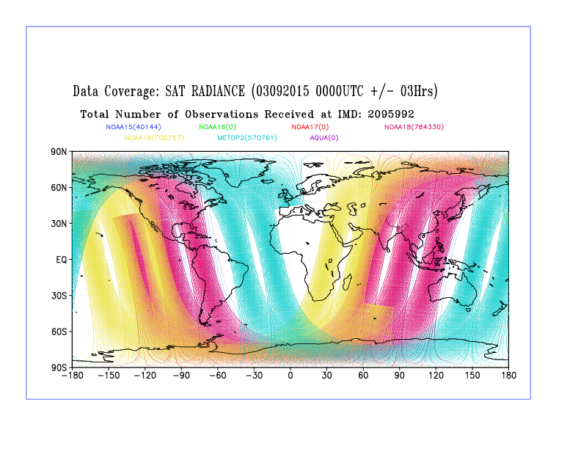
IMD`s Observational Status Report
Ashim Kumar Mitra
R.K Giri & V. Singh
INDIA METEOROLOGICAL DEPARTMENT
MAUSAM BHAVAN, LODI ROAD , NEW DELHI-110003
akmitra@imd.gov.in
Inputs;
Dr SL Singh,IMD
Sankar Nath,IMD
GODEX-NWP, 27-30 Nov 2018

Slide 2
VISION & MISSION of IMD
  No weather hazard should go undetected and unpredicted.
  Accurate, timely and actionable warnings against any hazards triggering response from the disaster managers and general public to save life and property.
The first one is possible only with satellite in the absence of dense observational network and DWR in the country for mainly synoptic and meso-scale weather hazards
IMD using space technology since 1960s for synoptic scale systems like cyclone monitoring with US collaboration.
Got a boost with INSAT series in 1982.
Current products from INSAT-3D/3DR, Kalpana & INSAT-3A

Slide 3
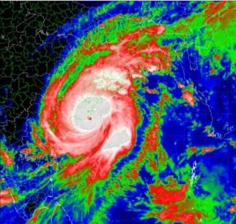
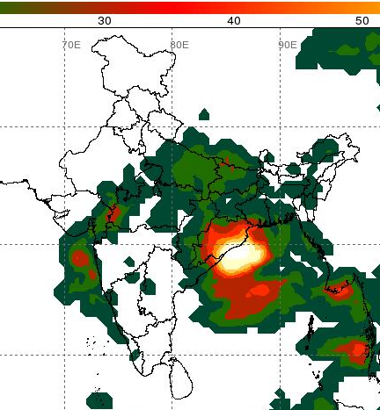
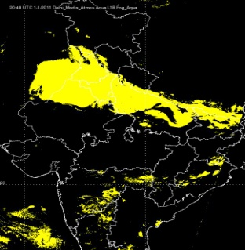
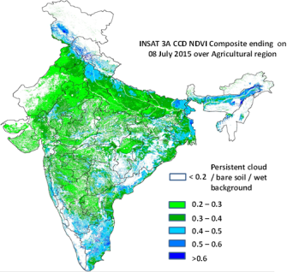
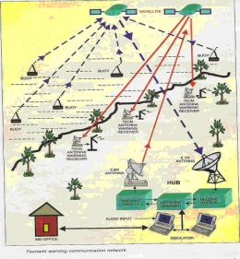
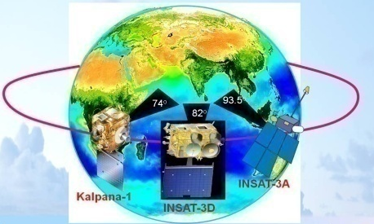
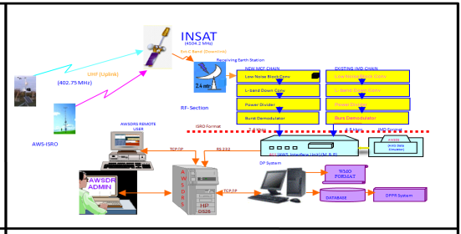
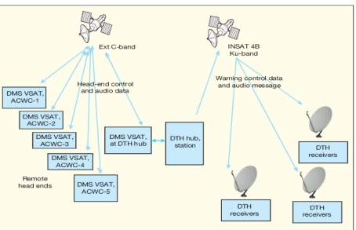
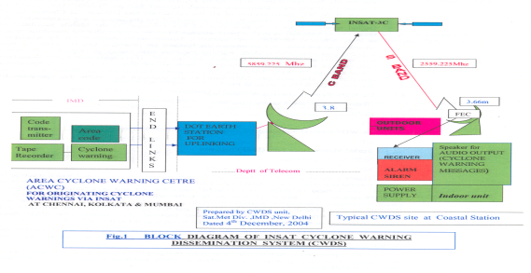
Current Status
Monitoring & Observations
  Monsoon
  Cyclones
  Thunderstorms
  Vegetation/Soil Moisture
  Clouds/Fog
  Ocean/Land/Atmosphere obs
Met Data communication
Defining Initial
conditions
of earth, ocean
& atmosphere
Warning Disseminations
Assimilated every 6 hours
  Typical No. of observations:
    Satellite: 32 GB
    Conventional: ~ 1 GB

Slide 4
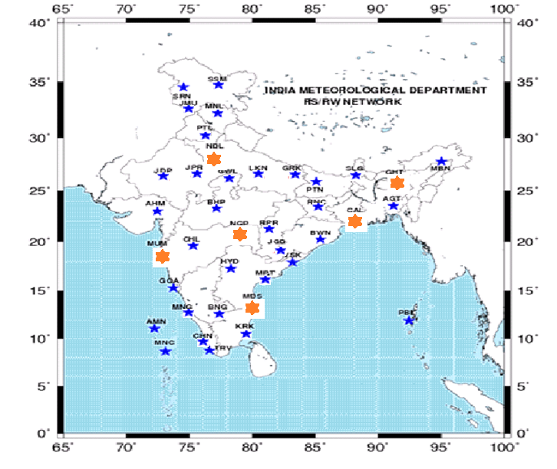
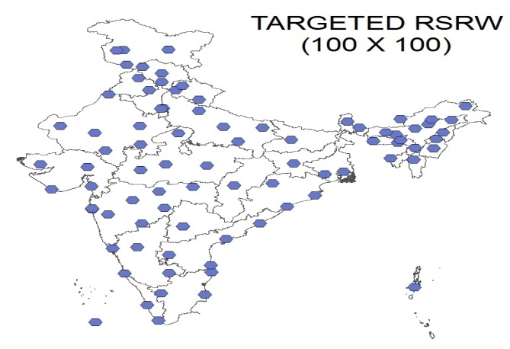
Upper Air Network
43 RS/RW stations upgraded with GPS based radio sounding systems.
Smooth production of indigenous GPS based Pilot-sonde - IMD Workshop at New Delhi.
Expansion of GUAN standard network from 6 to 12 stations to be completed by March 2019.
Expansion of RS/RW from 43 stations to 55 to be completed by March 2019.
Continuation of all 43 RS/RW stations with twice a day ascents.
2018
GUAN standard compatible RS/RW stations
Other GPS based stations
2019-20 (77 GPS)

Slide 5
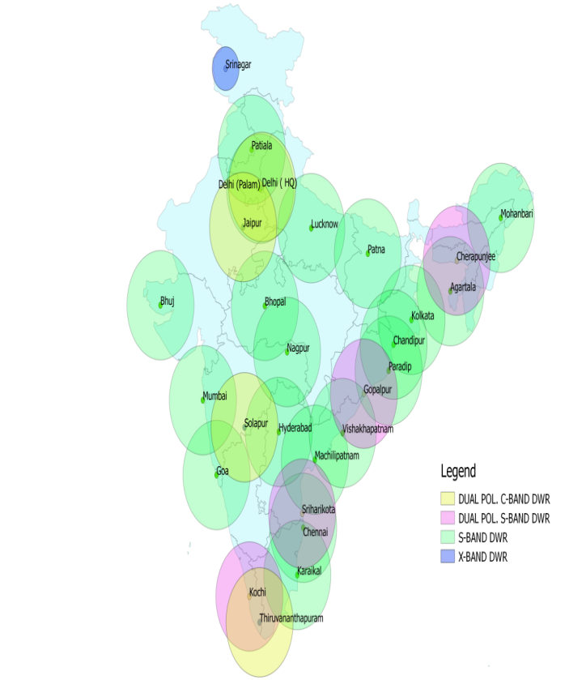
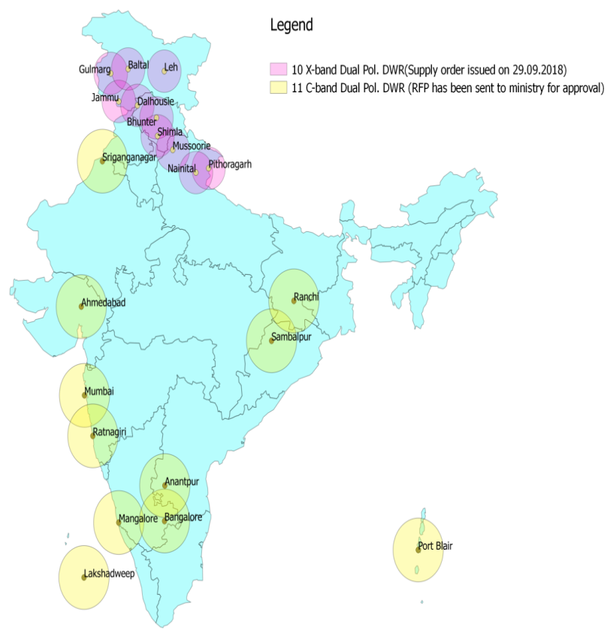
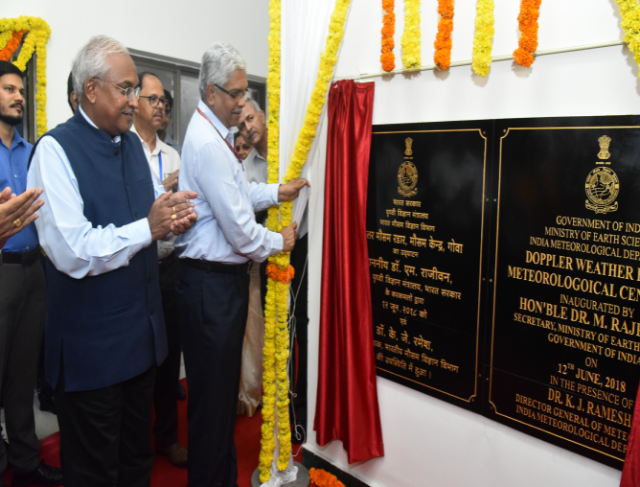
Doppler Weather Radar Network
Inauguration of DWR at Met Centre, Goa on 12-06-2018 for the service to the nation.
S.O issued for procurement of 10 X-band DWRS.
RFP for procurement of 11 C-band DWRs.
12 Nos. S-Band DWRs (Metstar)
02 Nos. C-Band DWRs (Vaisala).
02 Nos S-Band DWRs (BEL.
02 Nos. S-Band DWRs (BEL)
o1 No. X-Band DWR.
Up-gradation of 04 Nos S-Band DWRs (Gematroniks) to be processed under MOU with ISRO.
C Band
11+11*
Compact DWR
12
X Band
10+14
Proposed for 2019-20
IAF
11*
IMD
10+ 11
2018

Slide 6

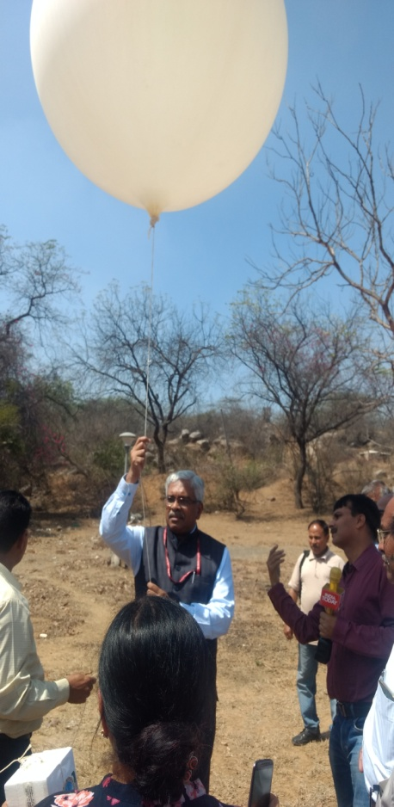
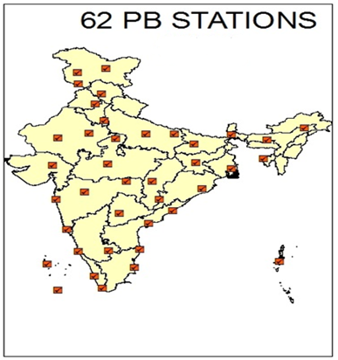
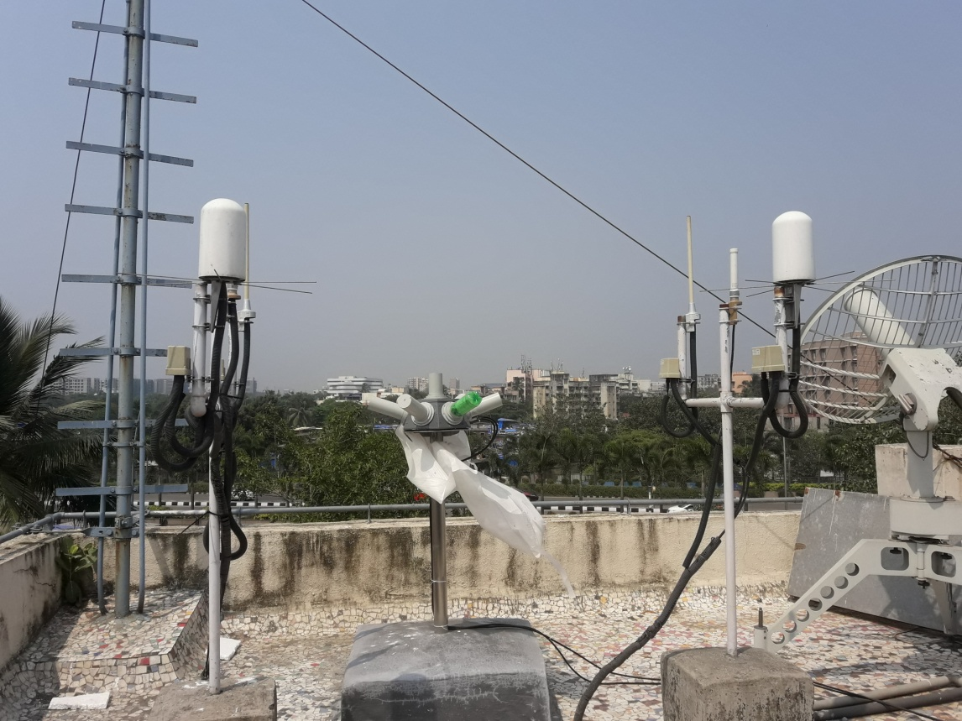
Pilot Balloon Network
Implementation of indigenous GPS based PB-sonde system done at New Delhi & Mumbai.
18 stations to be operationally up-graded with IMD make pilotsonde by December 2018. Remaining stations would be upgraded by March 2019.
40 PB stations also to be up-graded by other GPS based PB sonde.
Boost to Make in India and Digital India Initiative by IMD, MoES.

Slide 7
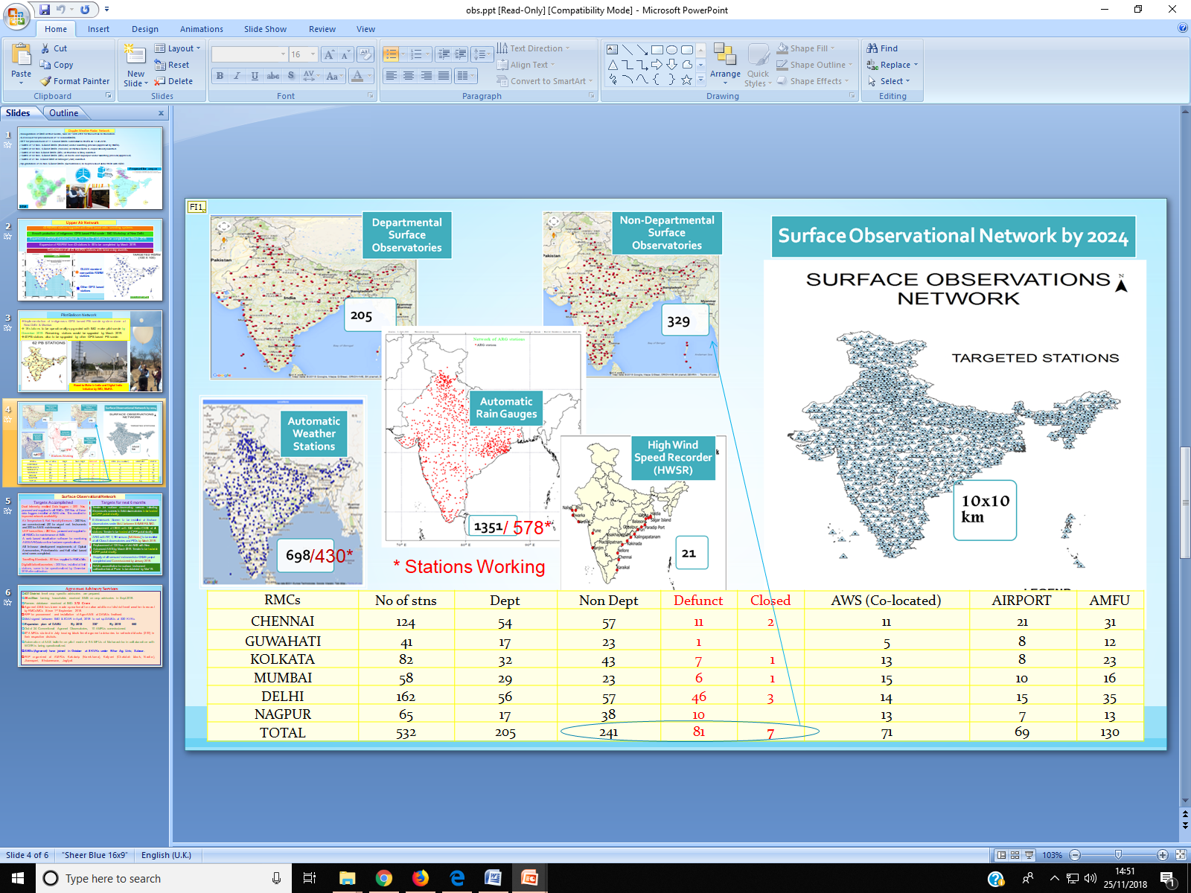

Slide 8
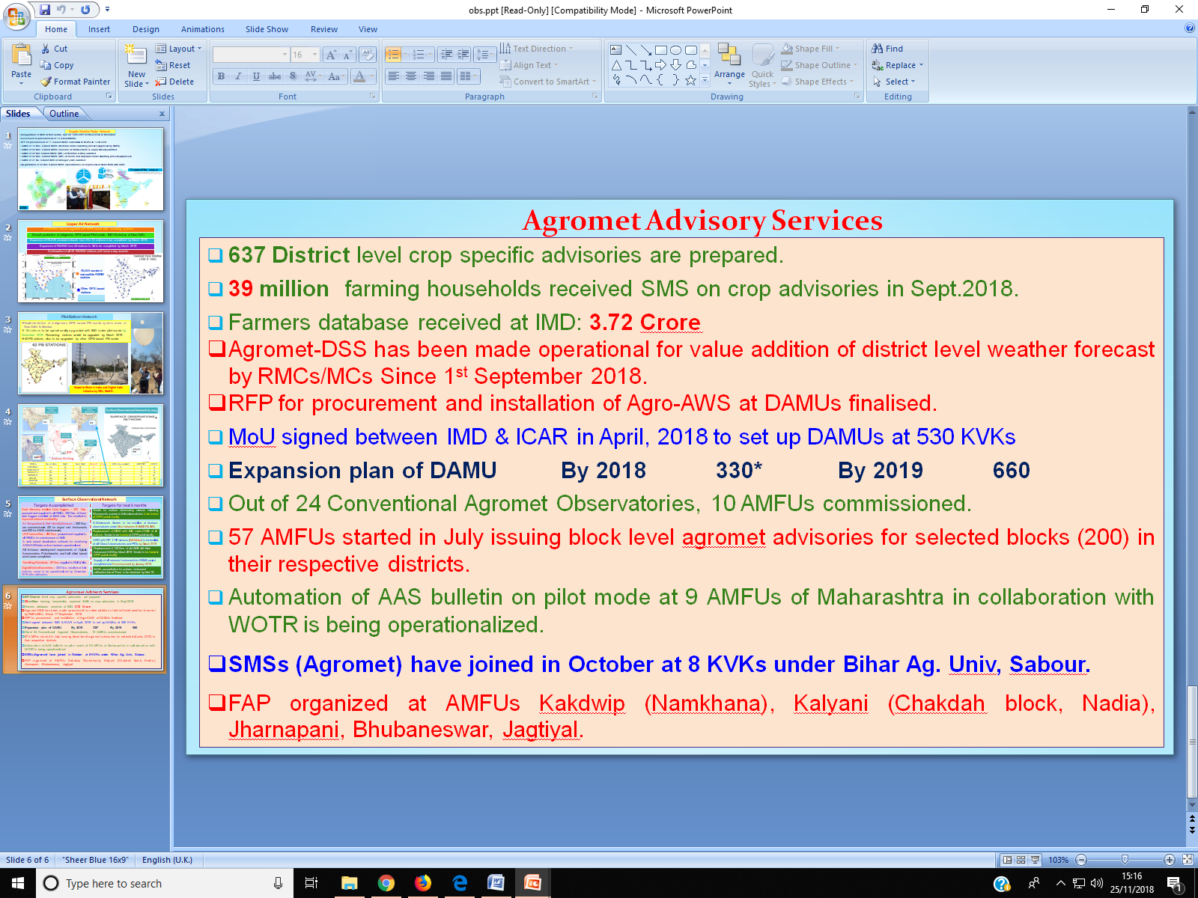

Slide 9
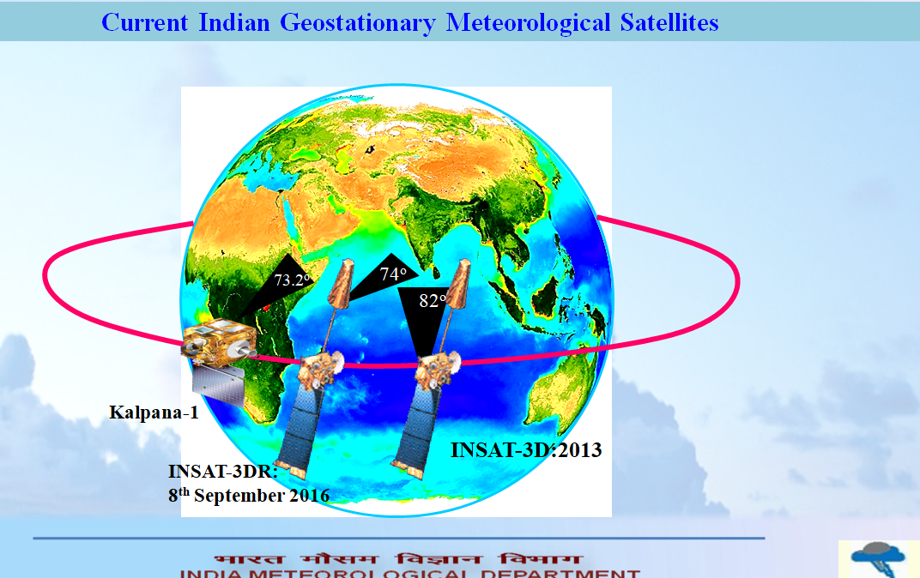

Slide 10
INSAT - 3D/3DR
Improved Understanding of Mesoscale Systems
6 Channel IMAGER
19 Channel SOUNDER
Spectral Bands (µm)
Visible : 0.55 - 0.75
Short Wave Infra Red : 1.55 - 1.70
Mid Wave Infra Red : 3.80 - 4.00
Water Vapour : 6.50 - 7.00
Thermal Infra Red – 1 : 10.2 - 11.3
Thermal Infra Red – 2 : 11.5 - 12.5
Resolution : 1 km for Vis, SWIR
4 km for MIR, TIR
8 km for WV
Spectral Bands (µm)
Short Wave Infra Red : Six bands
Mid Wave Infra Red : Five Bands
Long Wave Infra Red : Seven Bands
Visible : One Band
Resolution (km) : 10 X 10 for all bands
No of simultaneous : Four
sounding per band

Slide 12
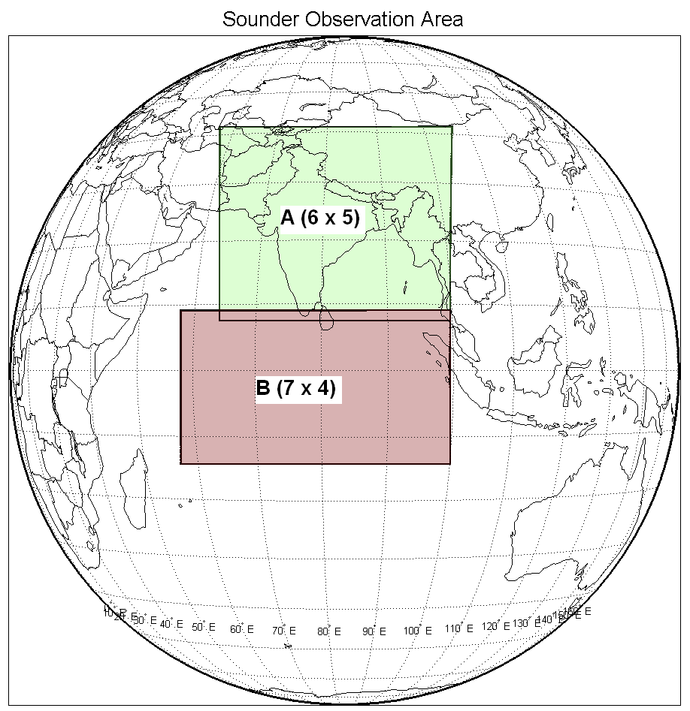
Present Operational Status
The present IMDPS system is used for processing and dissemination of data from all the three currently operational Geostationary satellites(Kalpana-1, INSAT-3D, INSAT-3DR).
INSAT Series | Temporal Resolution
3D -Imager (6 Channel) | ½ hourly (0000 & 0030 UTC)
3D -Sounder (19 Channel) | Hourly (Five times Region-A and sixth times region-B)
3DR -Imager (6 Channel) | ½ hourly (0015 & 0045 UTC)
3DR -Sounder (19 Channel) | Hourly (Five times Region-A and sixth times region-B)

Slide 13

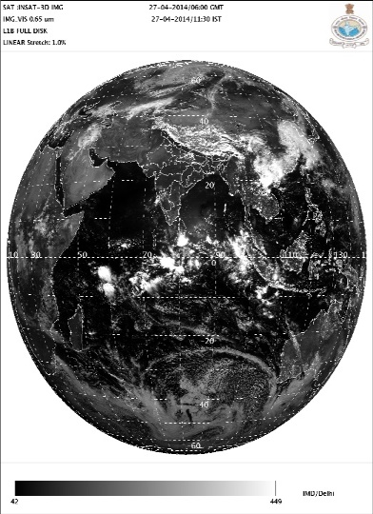
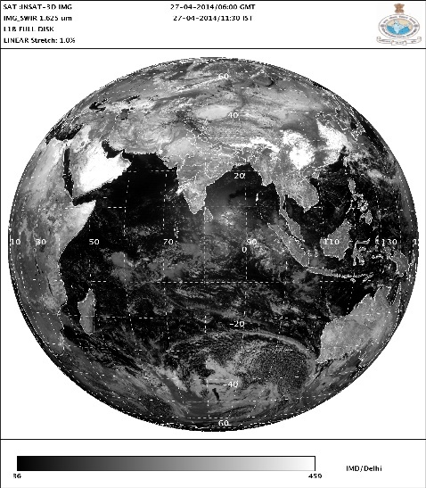
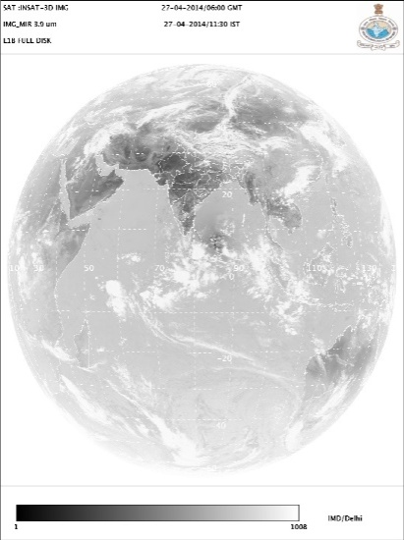
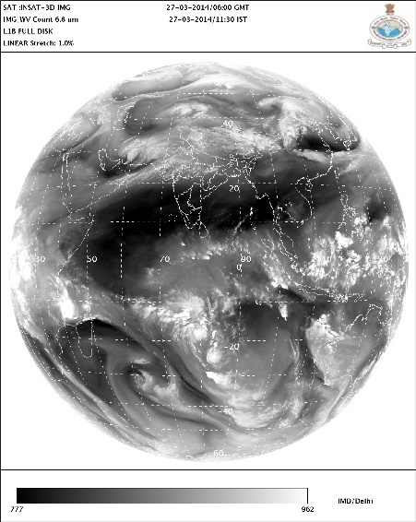
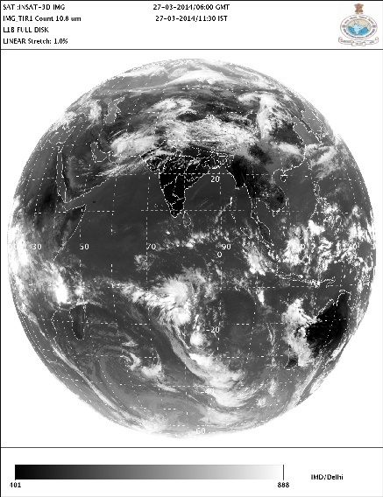
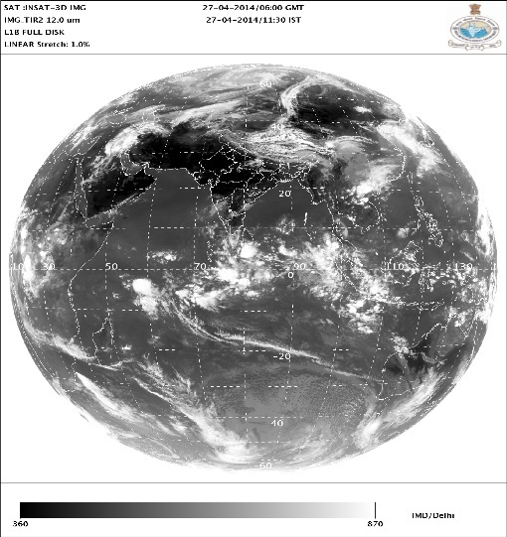
INSAT-3D Imager
Standard Products (L1B)
VIS (0.55-0.75µm)
SWIR(1.55-1.70µm)
MIR(3.80-4.00µm)
WV(6.50-7.10µm)
TIR-1(10.30-11.30µm)
TIR-2(11.50-12.50µm)

Slide 14
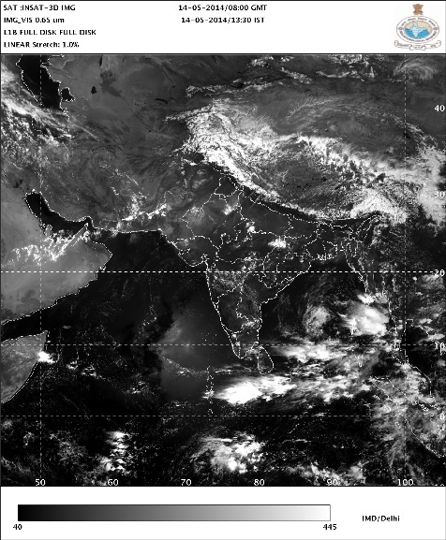
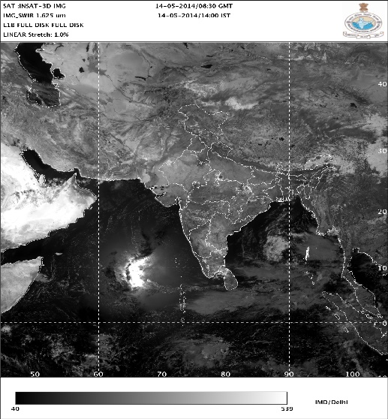
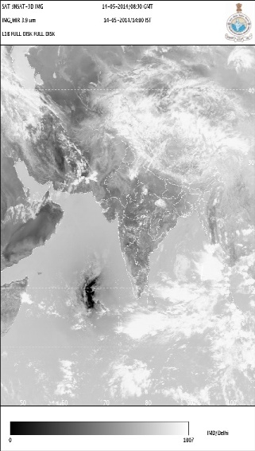
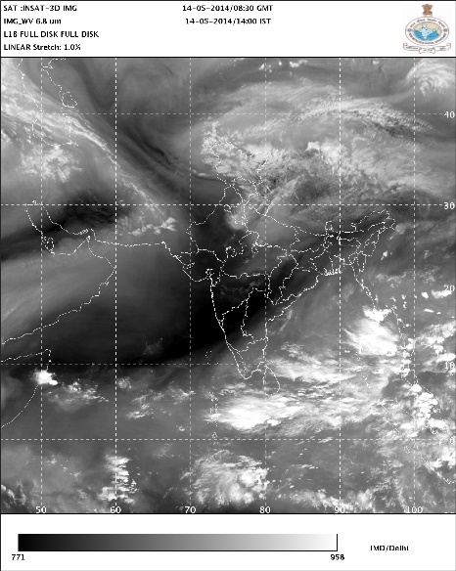
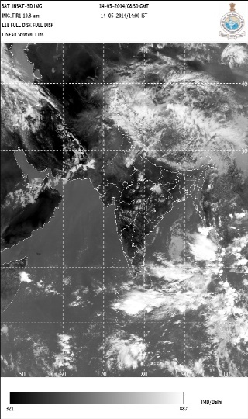

INSAT-3D Imager
Sector Products (L1C)
VIS (0.55-0.75µm)
SWIR(1.55-1.70µm)
MIR(3.80-4.00µm)
WV(6.50-7.10µm)
TIR-1(10.30-11.30µm)
TIR-2(11.50-12.50µm)

Slide 15
INSAT-3D/3DR Imager Channel Specification and their uses
Channels Number | Channel ID | Channel name | Spectral range (μm ) | Resolution (Km) | Purpose
1. | VIS | visible | 0.55 – 0.75 | 1.0 | Clouds, Surface features
2. | SWIR | short wave infrared | 1.55 – 1.70 | 1.0 | Snow, Ice and water phase in clouds
3. | MIR | medium wave infrared | 3.7 – 3.9 | 4.0 | Clouds, Fog, Fire
4. | WV | water vapour | 6.5 – 7.1 | 8.0 | Upper-Troposphere Moisture
5. | TIR1 | long wave infrared | 10.3 – 11.3 | 4.0 | Cloud top and surface temperature
6. | TIR2 | split | 11.5 - 12.5 | 4.0 | Lower-Troposphere Moisture

Slide 16
Detail of Images Generated from INSAT-3D/3DR Imager
Sector Name | Channels | No. of Images
Full-Disk | IR1, IR1_Temp, IR2, IR2_Temp, MIR, MIR_Temp, VIS, SWIR, WV, WV_temp, MP | 11
Asia-Sector | IR1, IR1_Temp, IR2, IR2_Temp, MIR, MIR_Temp, VIS, SWIR, WV, WV_temp, MP, CTBT | 12
NEQUAD-Sector | IR1, IR1_Temp, IR2, IR2_Temp, MIR, MIR_Temp, VIS, SWIR, WV, WV_temp, MP | 11
NWQUAD-Sector | IR1, IR1_Temp, IR2, IR2_Temp, MIR, MIR_Temp, VIS, SWIR, WV, WV_temp, MP | 11
SGP-Sector | IR1, IR1_Temp, IR2, IR2_Temp, MIR, MIR_Temp, VIS, SWIR, WV, WV_temp, MP | 11
NEQ (HR-Sector) | IR1_HR, IR1_HRBlue,IR1_Temp_BD, IR1_Temp_NHC, IR2_HR, IR2_HRBlue,VIS_HR, VIS_HRBlue, WV_HR, WV_HRBlue, MIR_HR, MIR_HRBlue, SWIR_HR, SWIR_HRBlue | 14
NWQ (HR-Sector) | IR1_HR, IR1_HRBlue,IR1_Temp_BD, IR1_Temp_NHC, IR2_HR, IR2_HRBlue,VIS_HR, VIS_HRBlue, WV_HR, WV_HRBlue, MIR_HR, MIR_HRBlue, SWIR_HR, SWIR_HRBlue | 14
Bay of Bengal (HR-Sector) | IR1_HR, IR1_HRBlue,IR1_Temp_BD, IR1_Temp_NHC, IR2_HR, IR2_HRBlue,VIS_HR, VIS_HRBlue, WV_HR, WV_HRBlue, MIR_HR, MIR_HRBlue, SWIR_HR, SWIR_HRBlue | 14
Arabian Sea (HR-Sector) | IR1_HR, IR1_HRBlue,IR1_Temp_BD, IR1_Temp_NHC, IR2_HR, IR2_HRBlue,VIS_HR, VIS_HRBlue, WV_HR, WV_HRBlue, MIR_HR, MIR_HRBlue, SWIR_HR, SWIR_HRBlue | 14
Amarnath Yatra (HR-Sector) | IR1_HR, IR1_HRBlue,IR1_Temp_HR, IR2_HR, VIS_HR, VIS_HRBlue, WV_HR, SWIR_HR, SWIR_HRBlue, MIR_HR, MIR_Temp_HR, | 11
Vaishno Devi (HR-Sector) | IR1_HR, IR1_HRBlue,IR1_Temp_BD, IR1_Temp_NHC, IR2_HR, IR2_HRBlue,VIS_HR, VIS_HRBlue, WV_HR, WV_HRBlue, MIR_HR, MIR_HRBlue, SWIR_HR, SWIR_HRBlue | 14
Nepal (HR-Sector) | IR1_HR, IR1_HRBlue,IR1_Temp_HR, IR2_HR, VIS_HR, VIS_HRBlue, WV_HR, SWIR_HR, SWIR_HRBlue, MIR_HR, MIR_Temp_HR, DMP | 12
Fog (HR-Sector) | IR1_HR, IR1_HRBlue,IR1_Temp_HR, IR2_HR, VIS_HR, VIS_HRBlue, WV_HR, SWIR_HR, SWIR_HRBlue, MIR_HR, MIR_Temp_HR, DMP, NMP | 13
 | Total No of Images generated half hourly | 162

Slide 17
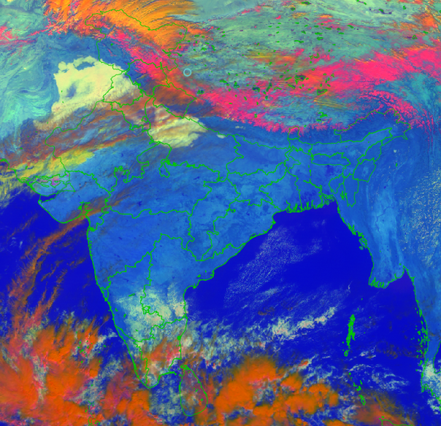
RAPID
RAPID(Real time Analysis of Products & Information Dissemination) :- It is a web based quick visualization and analysis tool for satellite data on a real time basis. This introduces Next Generation Weather Data Access & Advanced Visualization. http://www.rapid.imd.gov.in
Connects atmospheric- and geosciences
No specific OS/ software/ library / compiler required on the desktop. Access through browser.
Provides features of interest to scientific community
Open standards OGC
  Web Mapping Service (WMS) – For visualization
  Extensions written for scientific community
Zero learning curve

Slide 18
RGB Scheme of INSAT-3D
Methodology
A methodology for representing much of the physical information content of the METEOSAT Second Generation (MSG) geostationary satellite using red-green-blue (RGB) composites of the computed physical values of the picture elements is presented.
The physical values are the solar reflectance in the solar channels and brightness temperature in the thermal channels
“Day Microphysical”, presenting cloud microstructure using the solar reflectance component of the 3.9 μm, visible and thermal IR channels;
“Night Microphysical”, also presenting clouds microstructure using the brightness temperature differences between 10.8 and 3.9μm;
The scientific basis for these rendering schemes is implemented in IMDPS, New Delhi

Slide 19
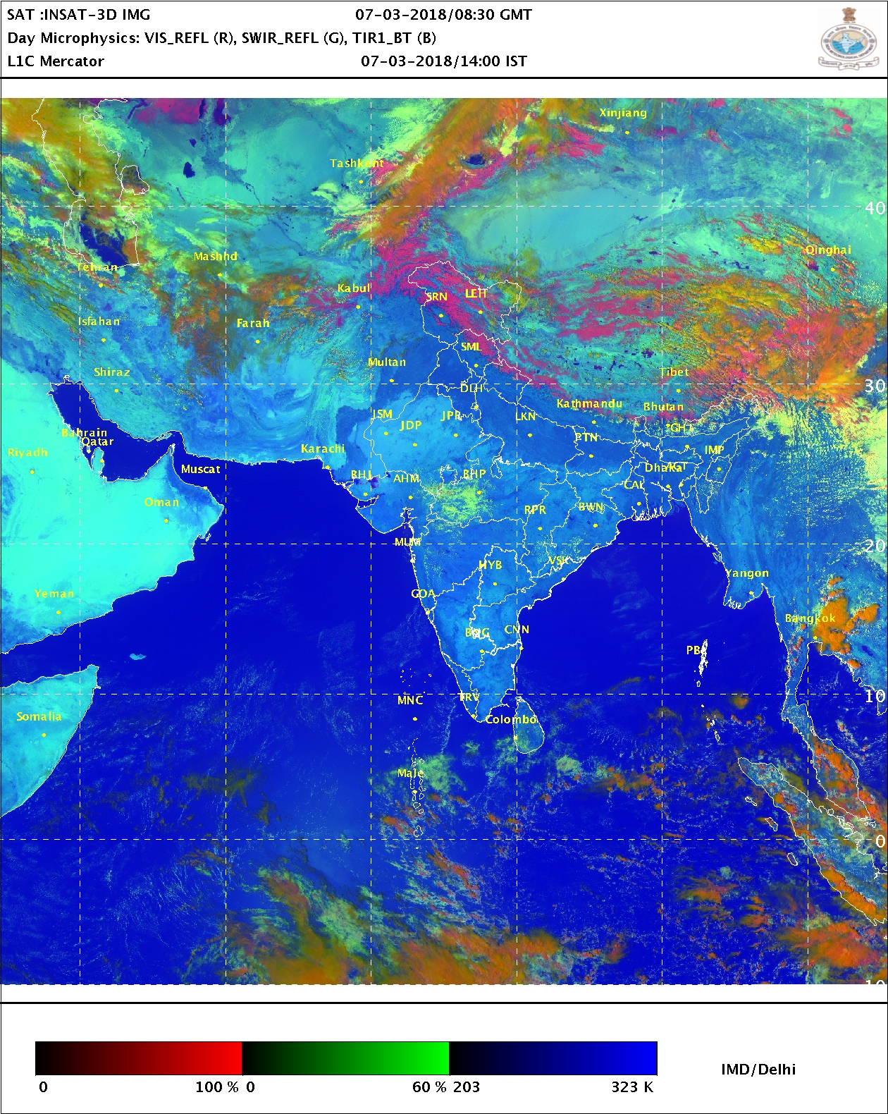
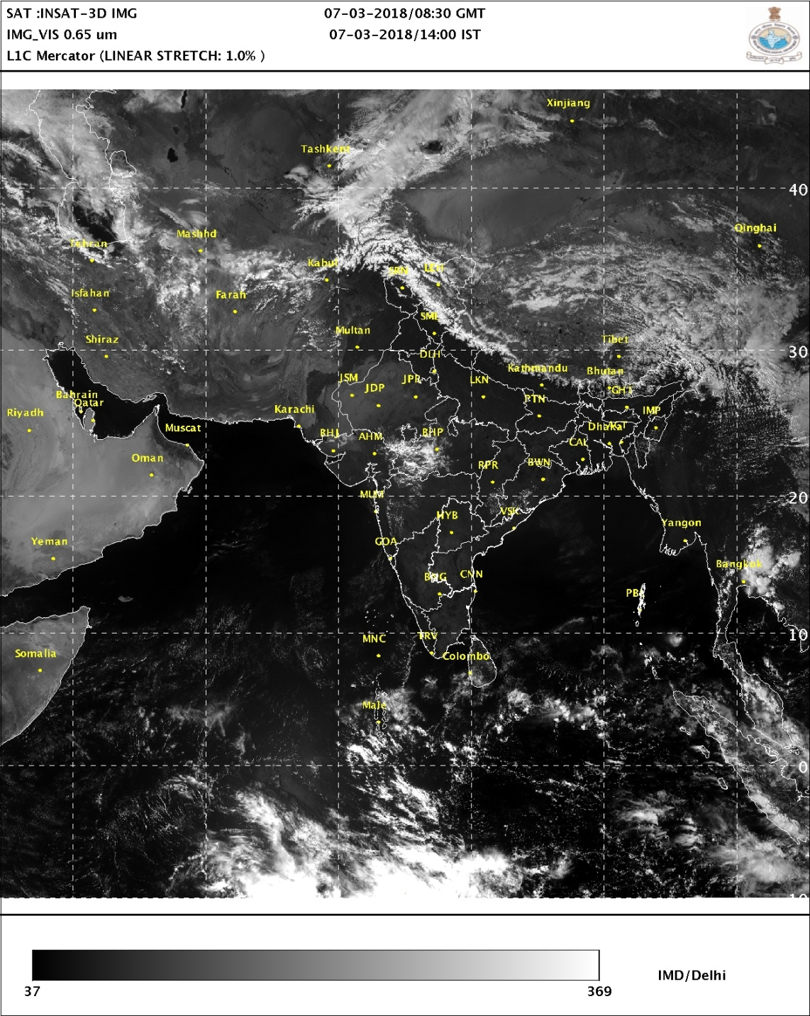
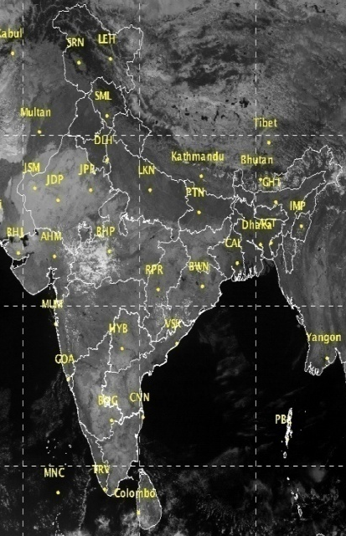
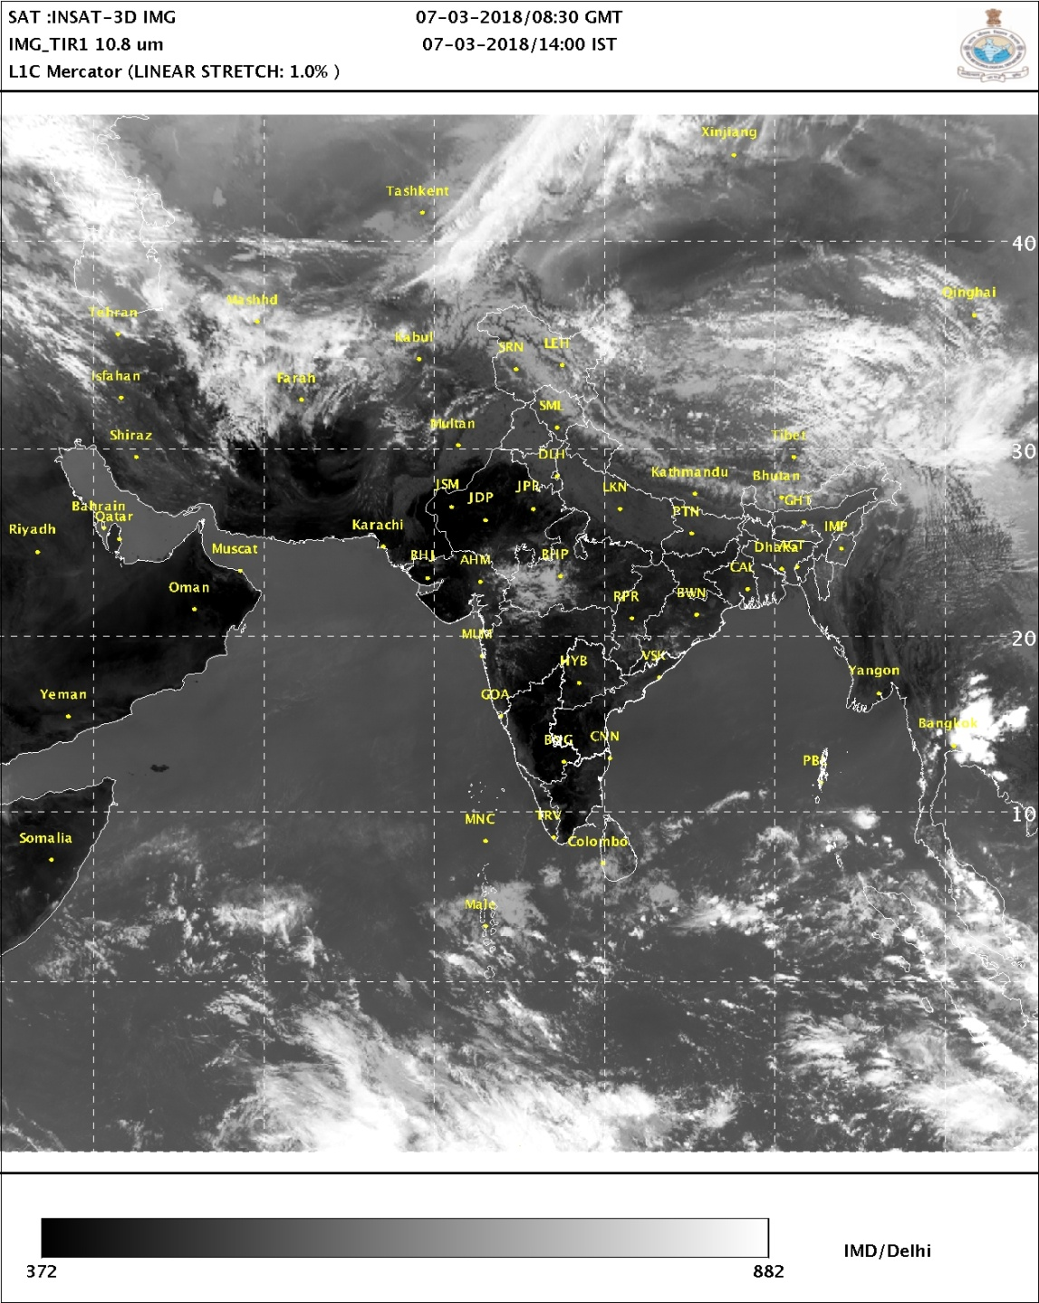
INSAT-3D Multispectral (RGB) Composites
RED
GREEN
BLUE
RGB
VIS (0.55-0.75um)
MIR 3.9 um
IR (10.8um)
SWIR (1.67um)
Multispectral or Red-Green-Blue (i.e. RGB) Composites are qualitative, false color images designed to enhance a specific feature :
Low clouds and fog ,Fire Hot Spots
Snow/Ice ,Cloud Phase, Volcanic Ash, Dust, Convection, Air Mass characteristics
The 10 bit false color image is created by combining band or band differences into each of the Red, Green, and Blue components with a defined recipe. The advantage of RGB products is the ability to look at a single image to identify a feature instead of analyzing multiple single channels.

Slide 20
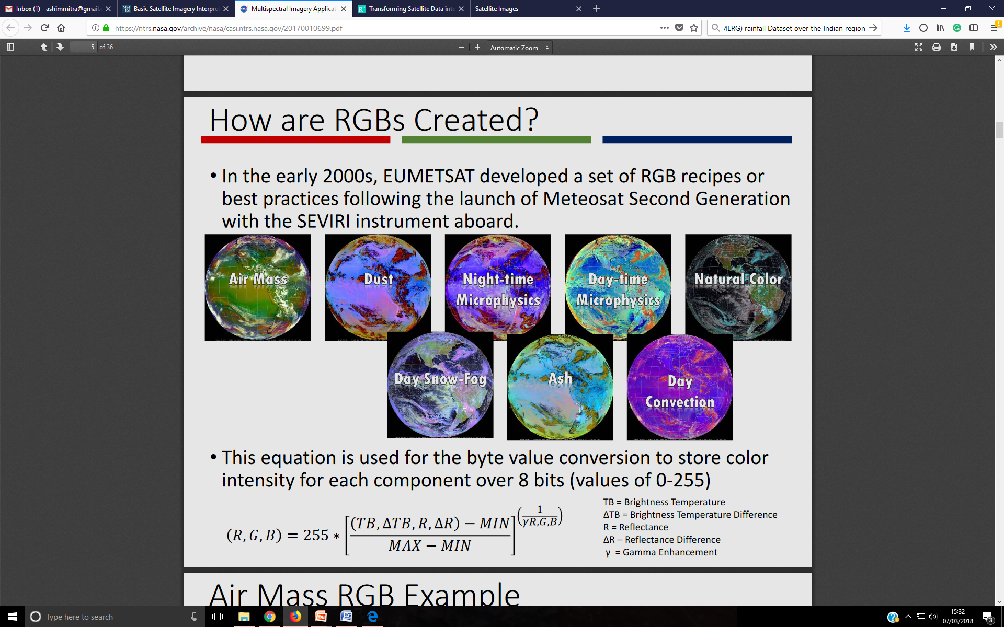

How are RGBs Created?
In the early 2000s, EUMETSAT developed a set of RGB recipes or best practices following the launch of Meteosat Second Generation with the SEVIRI instrument aboard.
It is based on considerable experience with the MSG imager SEVIRI. The image manipulations refer to reflectance factor values (RF) for solar channels and equivalent brightness temperature values (EBT) for infrared channels.
The enhancement operations expand to the full range of display values (0-1023, BYTE) a limited range (MIN, MAX) of RF or EBT values, applying subsequently a gamma correction2) (GAMMA) for possible non linear expansion
BT = Brightness Temperature
ΔBT = Brightness Temperature Difference
R = Reflectance
ΔR =Reflectance Difference, γ = Gamma Correction
The solar channels reflectance and brightness temperature (BT) of INSAT-3D thermal channels are key ingredients for the preparation of the day time and night time microphysical products.
Lensky et.al, (2008) technique (operational in EUMESAT) has been fine tuned according to INSAT-3D multispectral channel specification and implemented to INSAT Meteorological Data Processing System (IMDPS), IMD, New Delhi.
Here fine tuning is basically the adjustment of EUMETSAT RGB recipes to retain legacy coloring due to differing spectral characteristics between SEVIRI and INSAT-3D channels.

Slide 21
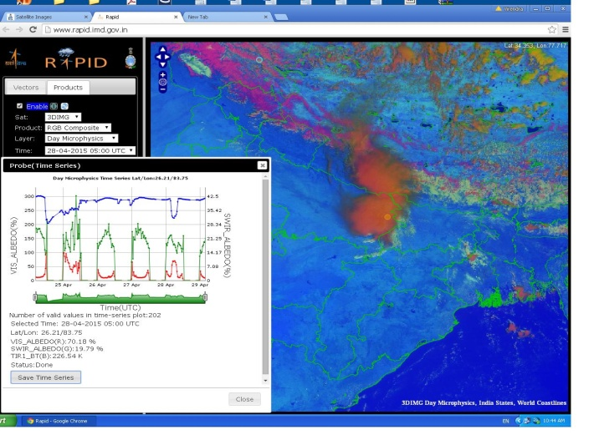
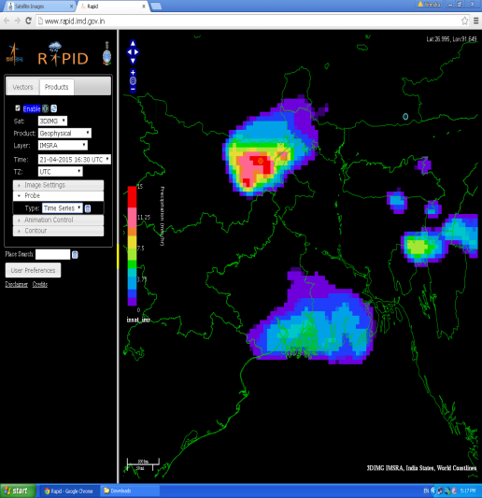
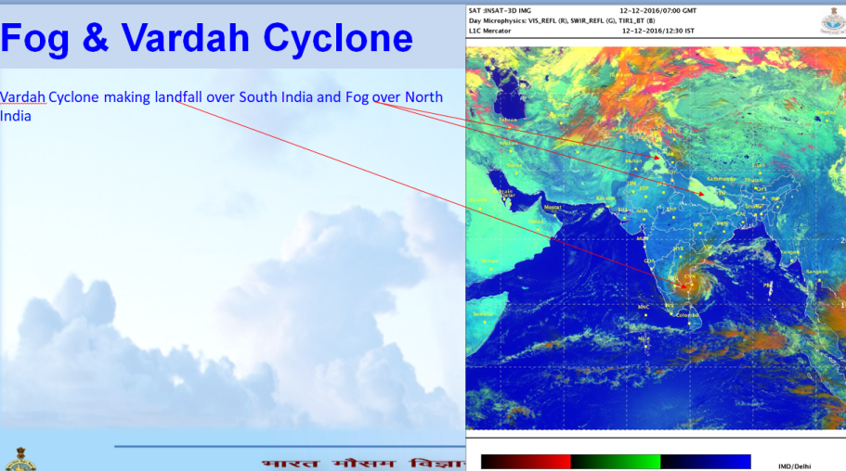
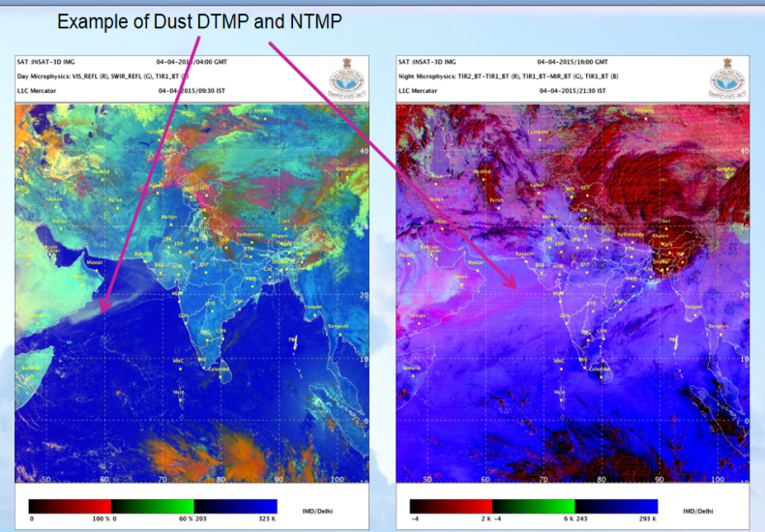
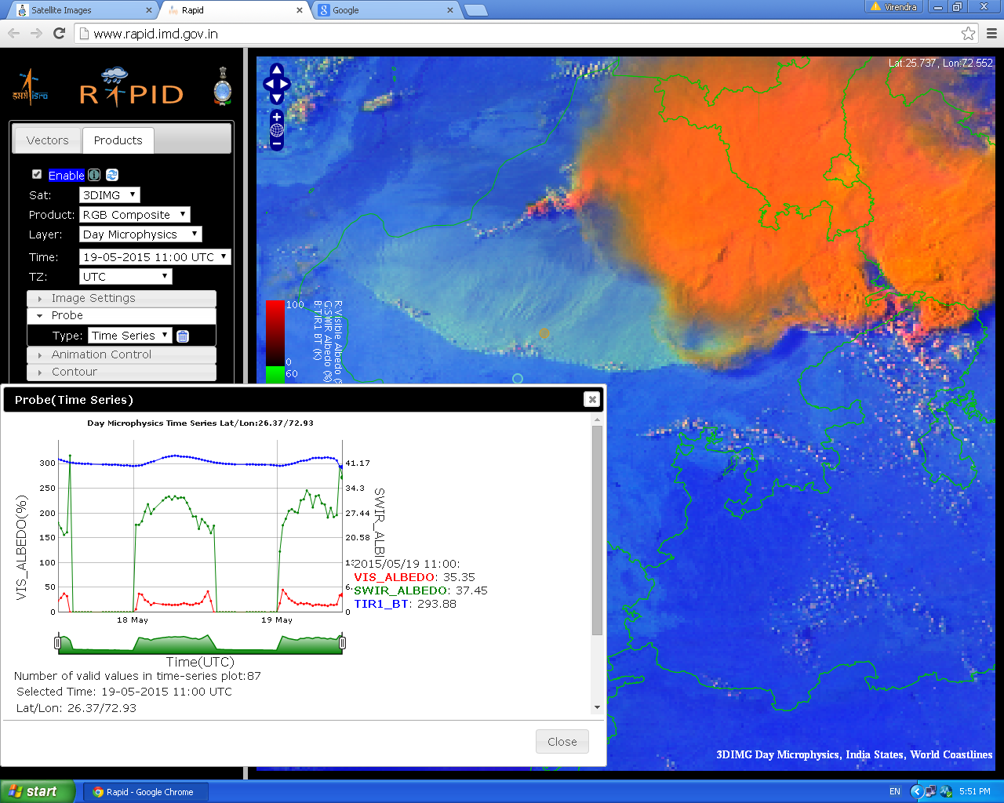
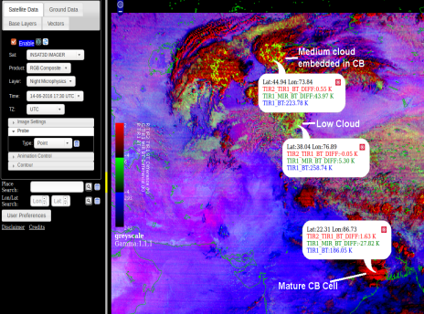
Weather Events using RAPID/RGB

Slide 22
Existing products from Indian Satellite used in weather forecasting
Satellite Images:
(a). IR, (b).VIS, (c). WV.
(d). Microwave (Not available)
Satellite Derived products from geostationary satellite:
(a). CMV/WVW (available with low accuracy)
(b). Rainfall products : QPE (available), QPF (not available)
Followings are not available
(b). Wind Shear.
(c). 24 Hrs Shear Tendency.
(d). Upper level Divergence.
(e). Low level Convergence.
(f). Vorticity (850, 700, 500 and 200 hPa
(g). Scatterometer winds
(h) Multi-satellite derived winds

Slide 23
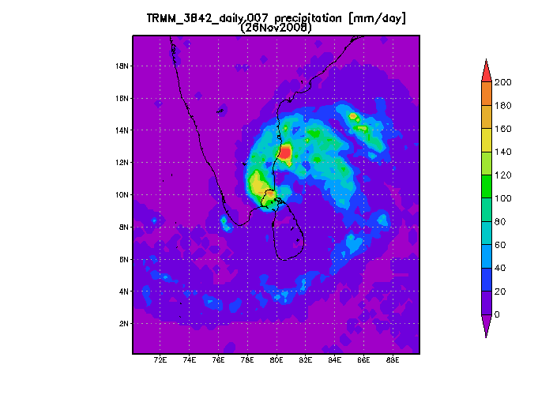
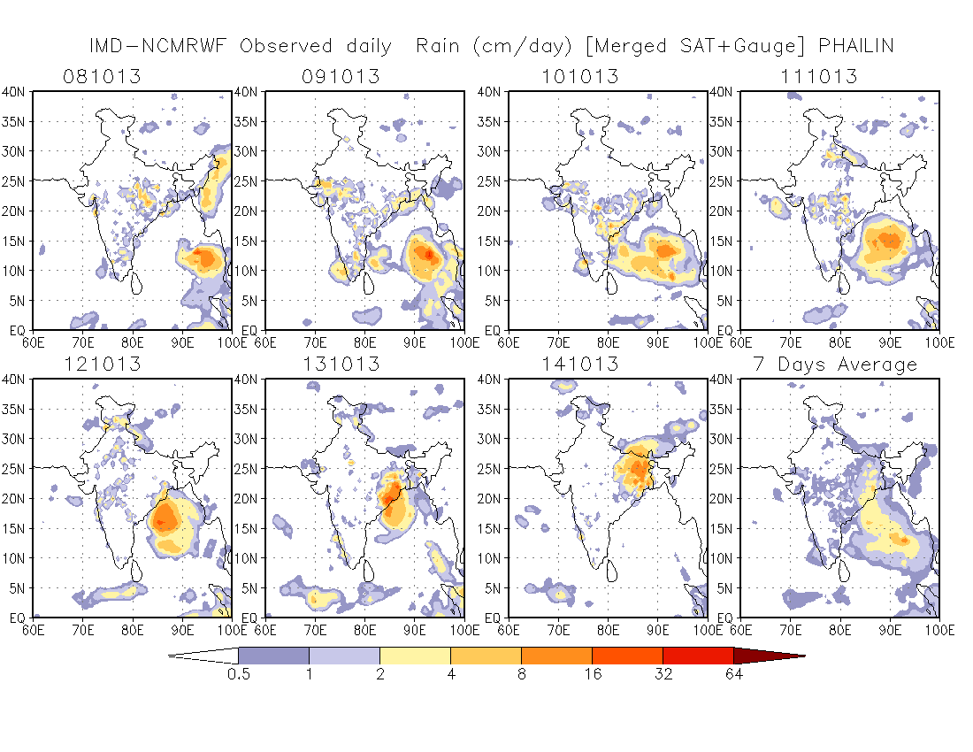
Space Technology and Rainfall Mapping
Rainfall, Monitoring
Rain gauge based monitoring
Satellite and Radar based monitoring
(ii) Gridded rainfall data ,
Satellite based merged gridded rainfall data
TRMM :Rainfall : Not available currently
Global Precipiotation Measurement (GPM)
TRMM :Rainfall due to Nisha as monitored by TRMM
Parameters | INSAT-3D
Method | Hydro-Estimate
Advantage | Convective & non-convective clusters are identified and different rainfall, temperature relationship are applied.
Improvements | 0.5 ° x 0.5° Limitaion of 72mm/3hr removed.

Slide 24
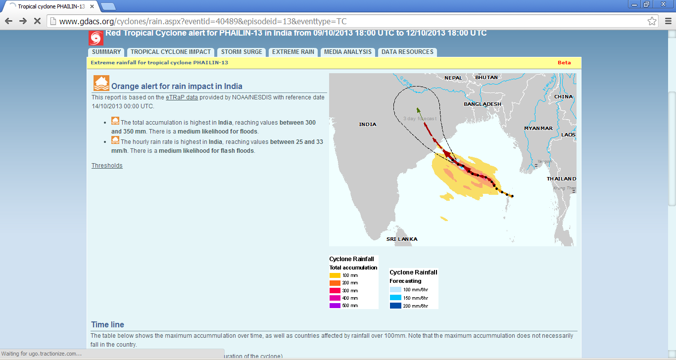
Satellite based QPF
Accumulated precipitation and forecast based on etrap: TC, Phailin

Slide 25
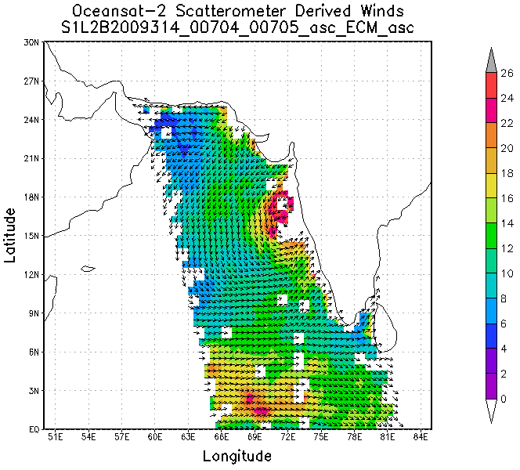
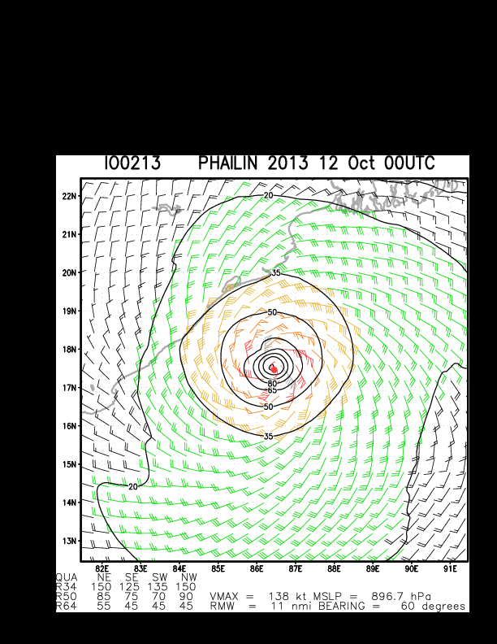
Sea surface wind
Multi-satellite surface wind

Slide 26


Slide 27

IMD Radar with Lightning data

Slide 28

RAPID SCAN OBSERVATION OF INSAT-3DR
Rapid scan imagery from INSAT 3DR can be used for the analysis of the genesis and evolution of squall lines and their fine structures.
Normal mode coverage in North-South direction is divided into 36blocks. Each block requires 45 seconds and covers 0.5o in N-S direction.

Slide 29

Proposed scanning strategy
While selecting the area of coverage for rapid scan, one has to strike the right balance between the extent of coverage and the number of repetitions.
The following are the key features of the proposal :
Chosen scheme : scheme #2 (7 blocks with 5repetitions).
Date: 15th May 2017.
Time : 06:15 UTC, 06:19UTC, 06:23UTC, 06:28UTC, 06:3 2UTC.

Slide 30



Slide 31




Calibration Activities at Satellite Division of IMD
Establishment of In-situ Calibration and Validation site for INSAT-3D/3DR satellite for Visible and SWIR sensor ( Project Partner: SAC,ISRO)
Overall 5 joint campaign (Cal/Val team) with SAC/ISRO team were carried out from 2013 to 2017 to find a suitable site after visiting several locations in this region for the purpose to get information of uniformity, accessibility, useable area and local information of the site.
The campaign results shows that Bhuj (Gujarat) site is the preferred site for post-launch calibration due to its accessibility, high degree of homogeneity, Stability in terms of atmosphere radiometrically stable and brightness is also significant which helps to derive precise vicarious calibration coefficients. The site is approved jointly by the IMD and SAC scientists.(Courtesy: Joint Scientific Report by SAC and IMD: SAC/EPSA/VRG/ERTD/01/2016).
Current Status: The Procurement of the instrument is about to complete.
Next Proposed Site: Leh , Ladakh.

Slide 32


Inter-calibration of imager observations from time-series of geostationary satellites (IOGEO),SCOPE-CM.
The major objective of this SCOPE-CM (Sustained and Coordinated Processing of Environmental Satellite data for Climate Monitoring) project is the generation of a Fundamental Climate Data Record (FCDR) of calibrated and quality-controlled geostationary sensor data.
The FCDR will contain the visible, IR window and water vapour absorption channels of geostationary satellites. It is proposed to utilise the inter-satellite methodology developed by GSICS to tie existing time series of satellite data to the best reference available in space.

Slide 33


DBNet Contribution from IMD
India Meteorological Department had procured and installed three ground receiving and processing systems for NOAA/METOP and MODIS satellites for New Delhi, Chennai and Guwahati.
It is a high end tracking antenna subsystem with radome following the EUMETSAT recommendation for METOP and also for NOAA (USA) and Chinese Polar Orbiting satellites along with a real time reception and processing of MODIS data and derivation of quantitative products.

Slide 34
Satellites acquired
The NOAA/METOP/MODIS ground station is a high-performance, dual X- and L-band system that tracks, receives and processes data from the
NASA Terra and Aqua satellites,
NOAA (18/19),
EUMETSAT MetOp satellites(MetopA and B)
NPP/CriS has started (passes are less)

Slide 35


From JMA monitoring

Slide 36


Slide 37

Development of IPWG inter-comparison (INSAT 3D/3DR rainfall) site over India-in progress
Dr Chris Kidd and IMD team is working – it will be completed by the end of 2018(Action-CGMS-45)
IMD
IMD/IPWG Website will be operational :March 2019

Slide 38
Data Transmitting through GTS
Surface Observations-SYNOP (90 RBSN)
Upper Air- RS/RW (43)
Pilot balloon- (62)
Satellite: AMV, Radiances, Scatsat-1, DBNet
Oceansat etc.
Through FTP: NOAA/Canada Met. (INSAT-3D 3-hrly-L1B)
5. Bouys,Argos,Ships, Tsunami.
6. Radar data

Slide 39
Thank you

